Slide 1
Overview of Canada:
GoC spending, Income & Taxation,
Aging & Healthcare
Ian Lee, PhD
Sprott School of Business
Carleton University

Slide 2
Disclosures
1. I don’t belong/donate to any political party
2. I do not consult to business
3. Only use GoC, CIHI & OECD data
4. Do not use claims by MPs or NGOs – as partisans and lobbyists

Slide 3
Big Picture Overview

Slide 4
OECD, Median income by country, 2019
Canada near top of wealthiest
ie OECD, countries
38 high income countries in OECD of 193 countries in world at UN
OECD, Society at a Glance, 2019, https://www.oecd-ilibrary.org/social-issues-migration-health/society-at-a-glance_19991290

Slide 5
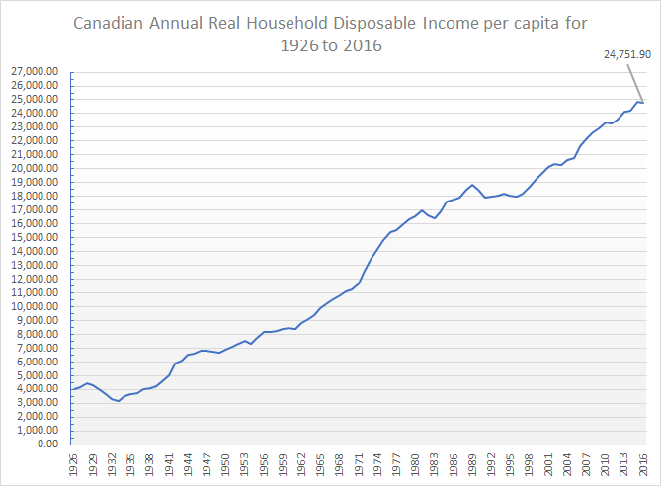
Cdn Real household disposable income per capita, 1926 - 2016
NOTE: Avg household income – inflation removed – has increased steadily for 95 yrs
No – the middle class did not collapse
SOURCE: https://www150.statcan.gc.ca/t1/tbl1/en/tv.action?pid=3610022901

Slide 6
Inequality & Poverty in Canada

Slide 7
Source of income data in Canada? – to measure inequality, poverty

Slide 8
CRA - Source of aggregated Cdn income data
CRA, Tax returns processed, 2018-2022
Total number of current year returns processed*
Tax-filing season | EFILE | % | NETFILE | % | FMR | % | Paper | % | Total
2022 | 17,495,718 | 59% | 9,813,951 | 33% | 52,712 | 0% | 2,126,378 | 7% | 29,488,759
2021 | 17,036,887 | 59% | 9,700,628 | 33% | 61,464 | 0% | 2,265,197 | 8% | 29,064,176
2020 | 16,706,414 | 58% | 9,647,130 | 33% | 69,634 | 0% | 2,530,392 | 9% | 28,953,570
2019 | 16,685,114 | 59% | 8,804,645 | 31% | 66,543 | 0% | 2,905,171 | 10% | 28,461,473
2018 | 16,276,753 | 58% | 8,485,520 | 31% | 47,195 | 0% | 3,133,947 | 11% | 27,943.415
29.5 Million Cdns filed - BUT only 19 M owed taxes –10 M more Cdns
file tax returns - as received benefits eg bursaries, govt income support
https://www.canada.ca/en/revenue-agency/corporate/about-canada-revenue-agency-cra/individual-income-tax-return-statistics.html

Slide 9
Stats Can, Top 1% tax filers, 2015-19
Income groups | Top 1 percent income group
Income concepts | Total income⁵
Statistics | 2015 | 2016 | 2017 | 2018 | 2019
 | Current dollars
Threshold value^{4, 6} | 234,700
 | Persons
Number of tax filers | 270,930 | 273,895 | 277,695 | 283,005 | 287,490
Current dollars
Median income⁴ | 331,100 | 307,200 | 323,500 | 338,400 | 345,300
Average income⁴ | 529,600 | 433,500 | 477,700 | 496,200 | 513,700
Percent
Share of income⁷ | 11.3 | 9.3 | 9.9 | 10.0 | 10.1
Myth of large numbers of very wealthy Cdns – is $235K/yr extreme wealth?
Source: https://www150.statcan.gc.ca/t1/tbl1/en/tv.action?pid=1110005501

Slide 10
Bank of Canada Governor Macklem, Income share of top CDN earners peaked in 2006
Claim that income inequality is skyrocketing is false
https://www.bankofcanada.ca/wp-content/uploads/2020/09/remarks-2020-09-10.pdf#chart6

Slide 11
Stats Can, Elder poverty collapsed in Canada, 1976-2011 – not going up
Before 1965, poverty mostly elders –
Passage of OAS, GIS, CPP & public
healthcare in 1965-68 dramatically reduced
elder poverty
Meredith, Lower risk, higher reward, IRPP, 2015

Slide 12
OECD, Comparative elder poverty rates
Cdn elder poverty BELOW OECD avg, below Sweden, Germany, Switzerland

Slide 13
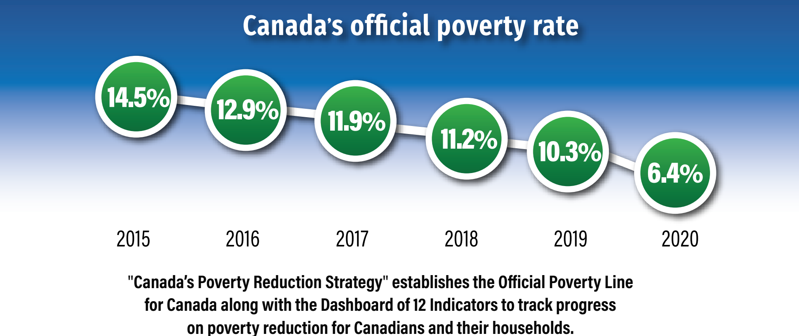
Stats Can, Poverty rate, 2015-2020 – lowest in Cdn history
https://www150.statcan.gc.ca/n1/pub/11-627-m/11-627-m2022011-eng.htm

Slide 14
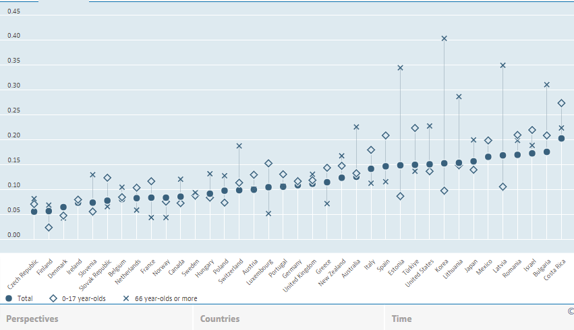
OECD, Comparative Poverty Rates, 2021
Canada below NZ, Sweden, Germany!
11th lowest of 193 countries in world
https://data.oecd.org/inequality/poverty-rate.htm#indicator-chart

Slide 15
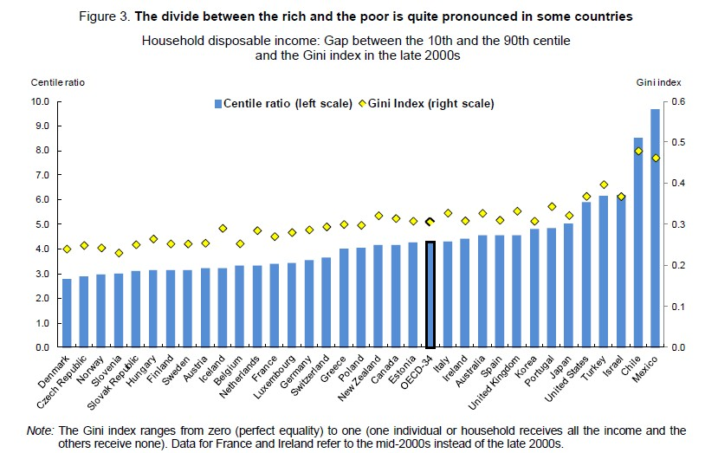
OECD, Inequality Ratio – Canada just BELOW avg of wealthy countries

Slide 16
Shares of Personal Taxes paid & income earned by quintile, 2021
Also see Philip Cross, MLI, Giving & taking away: How taxes and transfers affect inequality in Canada
Top 40% of Cdns pay 84% of all personal income taxes in Canada
While bottom 40% pay 5.7% of all personal income taxes in Canada

Slide 17
Net worth, home ownership & taxation
Millennials are “generation screwed”!
Really?

Slide 18
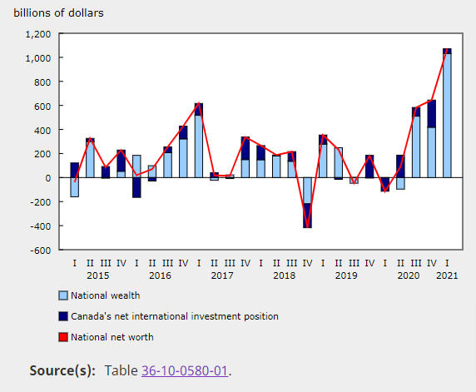
Stats Can, National Net Worth, 2023
AKA “Bank of Mom & Dad”
30 M Cdns OWN $16 TRILLION of assets
-$2.5T in debts
= Net $13.5 T
Or AVERAGE
+$400K each
https://www150.statcan.gc.ca/n1/daily-quotidien/210910/dq210910b-eng.htm

Slide 19
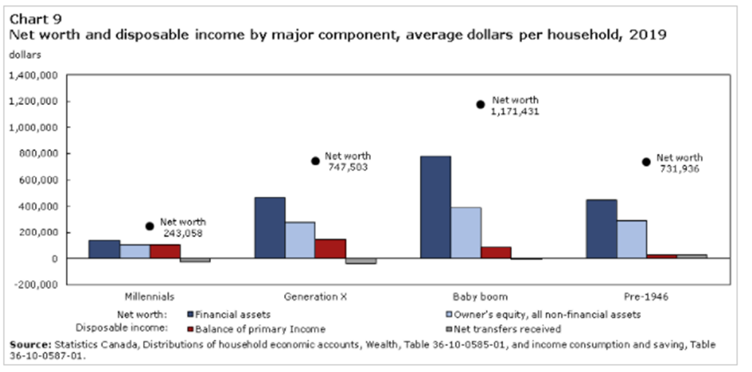
Stats Can, Net Worth & Disposable Income by Age Cohort, 2019
Average wealthiest Cdns are boomers who are mostly over 65
Source: https://www150.statcan.gc.ca/n1/pub/13-605-x/2020001/article/00006-eng.htm

Slide 20
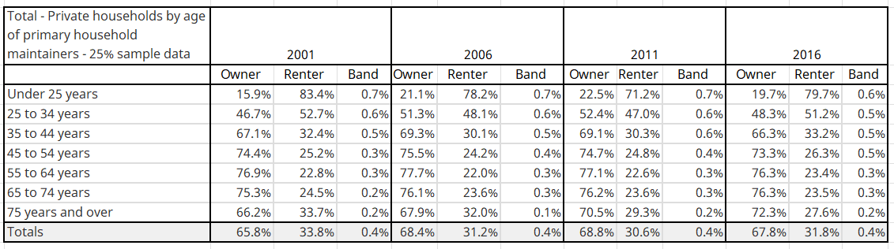
Stats Can, Homeownership & renter housing rates by age cohort, Canada, 2001 to 2016
Source: compiled from 2001, 2006, 2011 & 2016 Censuses
Note 25-34 years with 48% home ownership – NOT zero or very low %

Slide 21
What did Govt of Canada do during COVID?
Far too much fiscal stimulus – Relative to crisis
Relative to Income support already being spent

Slide 22
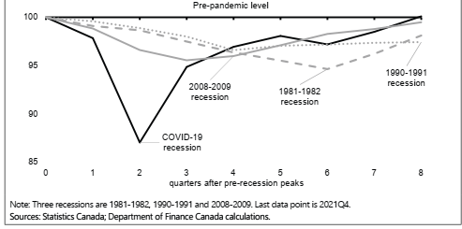
Cdn GDP Change, COVID vs past recessions
COVID recession much deeper but FAR FAR shorter

Slide 23
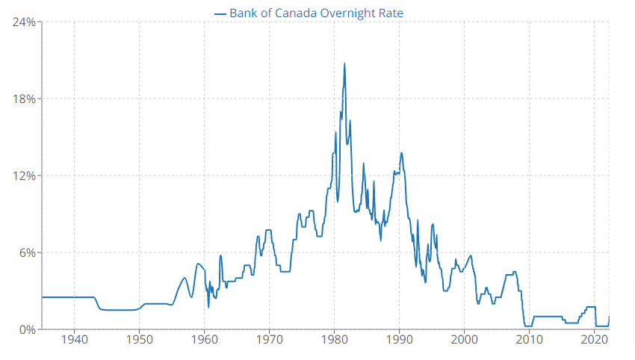
Bank of Canada, Overnight interest rate, 1935-2020
Interest rates NEVER this low in Canada

Slide 24
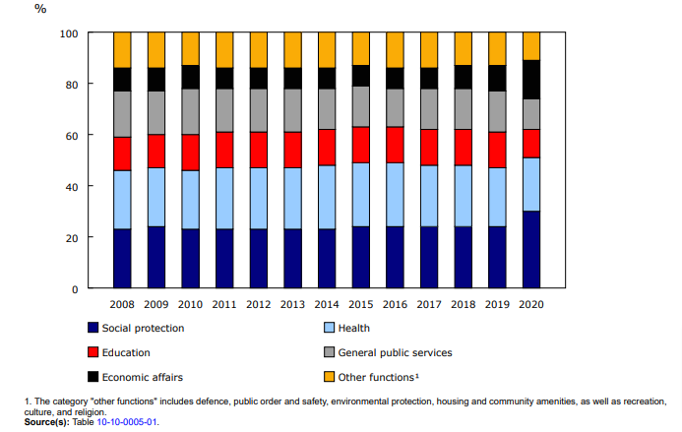
Stats Can, Share of consolidated govts expenses by function, 2008-20
60% of ALL govts spending on social protection, health care & ed
+$500 BILLION on social, health & ed in $2 Trillion GDP ie 25%
NO – the social safety net is NOT broken
Source: https://www150.statcan.gc.ca/n1/en/daily-quotidien/211126/dq211126a-eng.pdf?st=3XHkskXm

Slide 25
GoC & Prov Govts - COVID Support: $624 BILLION
Source: Finance Canada, Budget 2021

Slide 26
BoC, Extra savings by quintile, 2020
Bottom 40% of Cdns saved 25% of total savings during COVID
- NOT just high income earners
Source: https://www.bankofcanada.ca/2021/04/mpr-2021-04-21/

Slide 27
CIBC, Cdn savings rate, 1981, 1991, 2008 & Now
Cdns saved vastly more during pandemic – 25%
Source: https://economics.cibccm.com/cds?id=ea34b9ef-0ff1-4d76-ab25-a2e966d0cdb2&flag=E

Slide 28
Aging & Health Care Spending
Vastly larger crisis

Slide 29
Stats Can, % of Cdns over 65, 2016-2030
Source: https://www.statcan.gc.ca/en/subjects-start/older_adults_and_population_aging

Slide 30
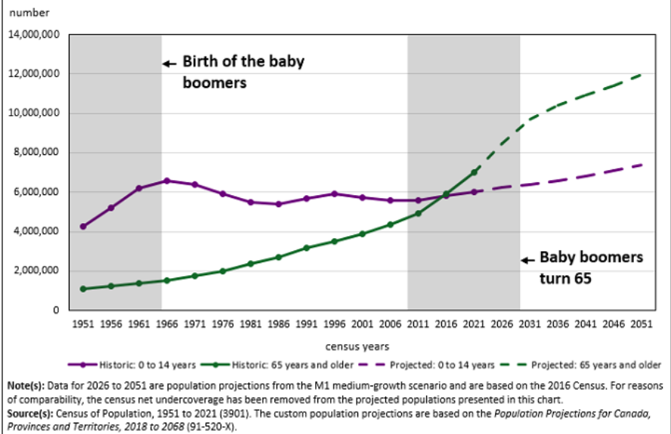
Stats Can, Less under 15 than over 65, 1951-2051

Slide 31
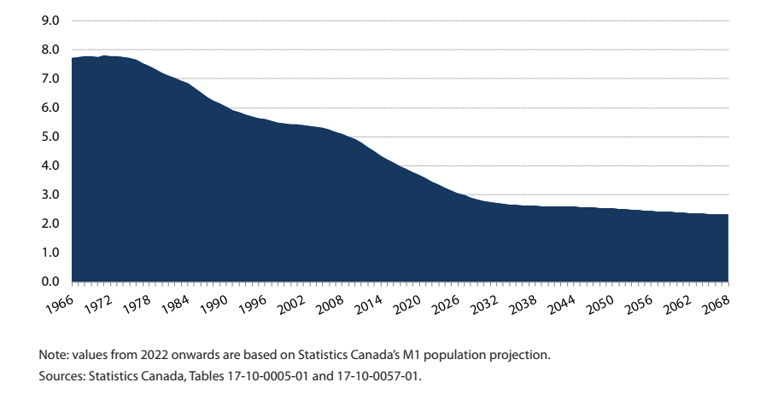
Stats Can, Dependency Ratio Historic & projected, 1966-2068
Workers to retirees went from 8:1 in 1966
To about 3:1 in 2025
Source: https://www150.statcan.gc.ca/n1/pub/82-229-x/2009001/demo/dep-eng.htm

Slide 32
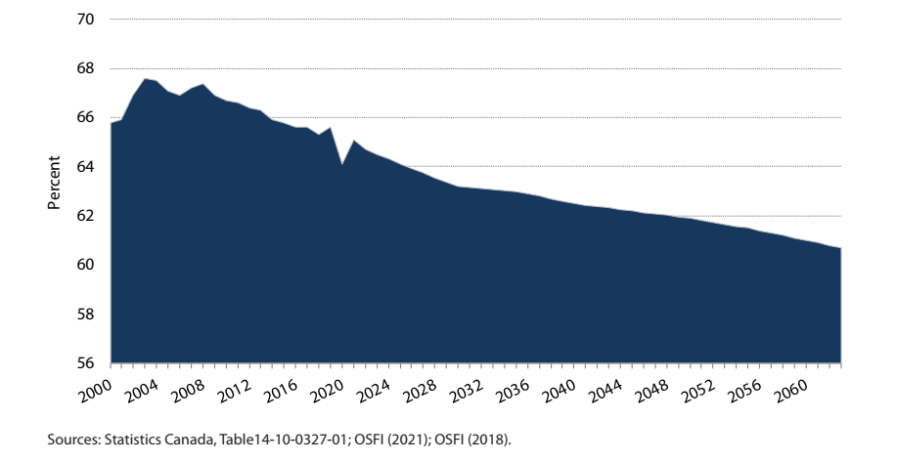
Stats Can, Labour force participation rate, 2000-2060
Do NOT need more generous income support
Need ALL hands on deck

Slide 33
Stats Can, Cdn health care annual spending as % of GDP
Forecast to increase from 5% to 12% of GDP by 2030
https://ifsd.ca/web/default/files/Reports/1-Health%20Care%20Costs-%20A%20Challenge%20for%20Canadian%20Governments.pdf

Slide 34
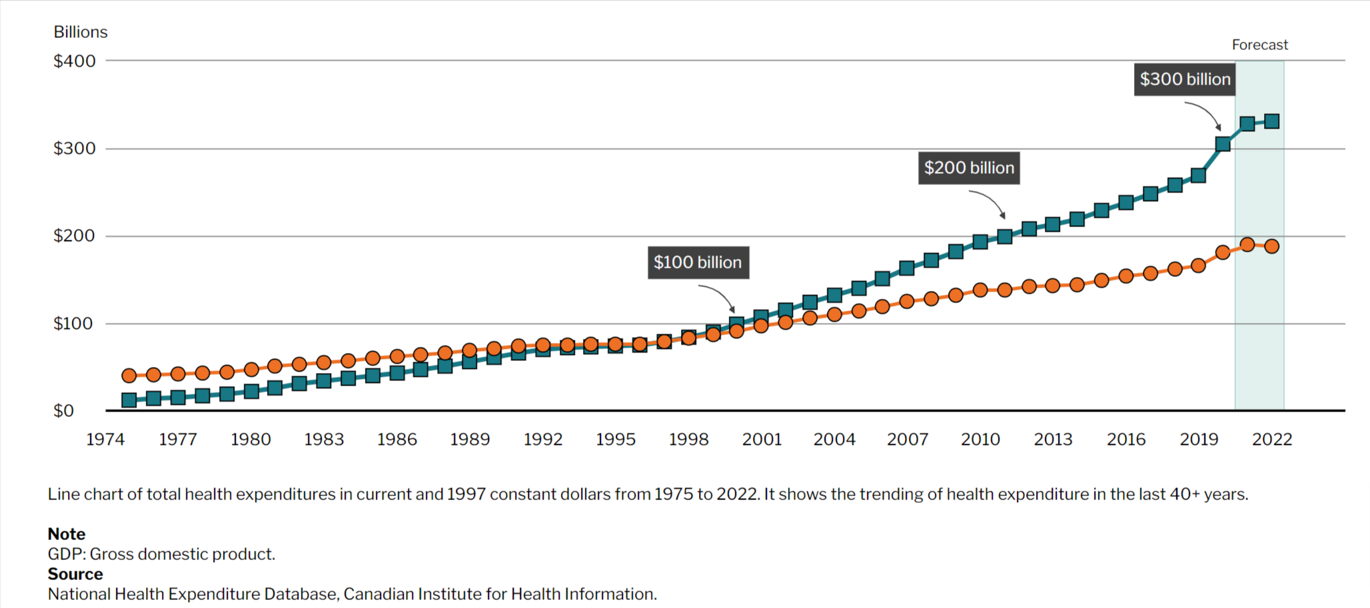
CIHI, CDN Health spending, inflation removed, 1975-2022

Slide 35
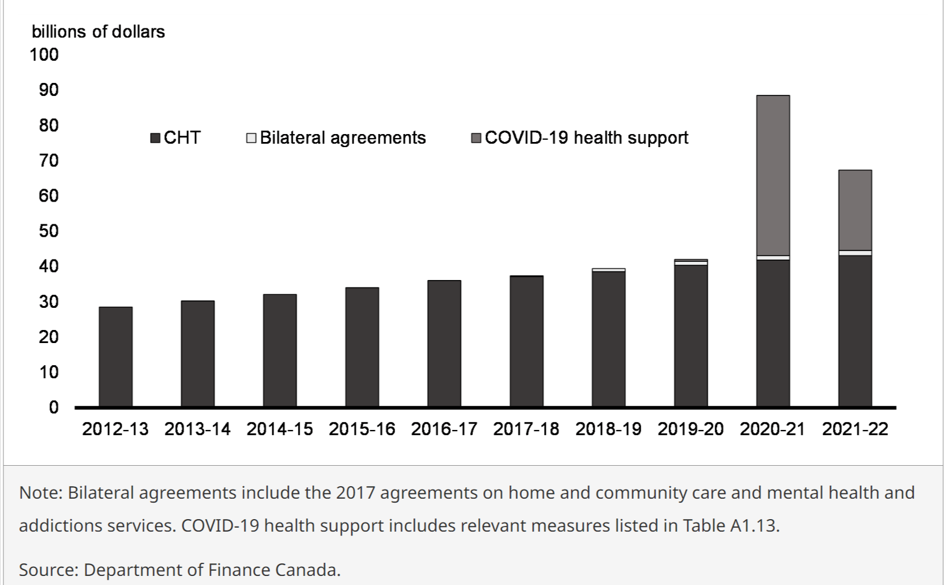
Finance Canada, GoC spending on health care, 2022

Slide 36
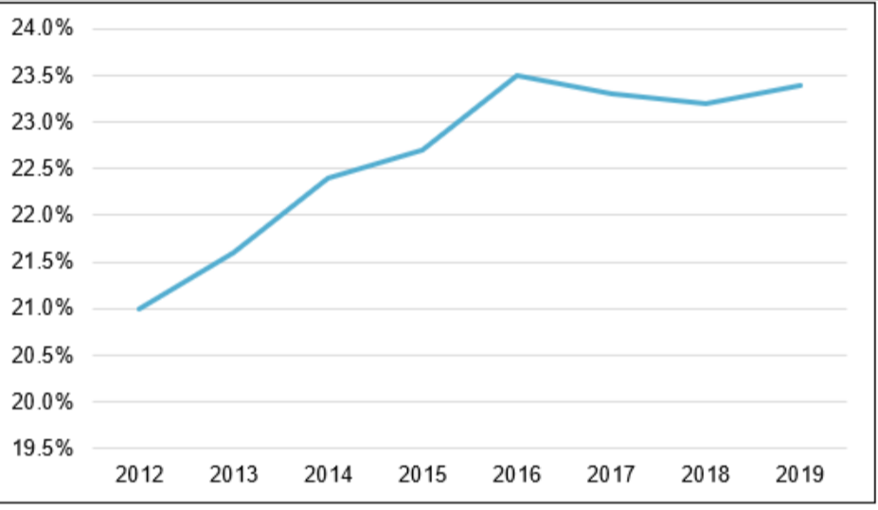
% of public health expenditures covered by GoC CHT, 2012-19
C

Slide 37
Stats Can, CDN Health care expenditure per capita by age
65 and older consumer 2X to 8X more per person than under 65
Source: https://www.cihi.ca/sites/default/files/document/nhex-trends-2020-narrative-report-en.pdf
This is why health care spending will skyrocket

Slide 38
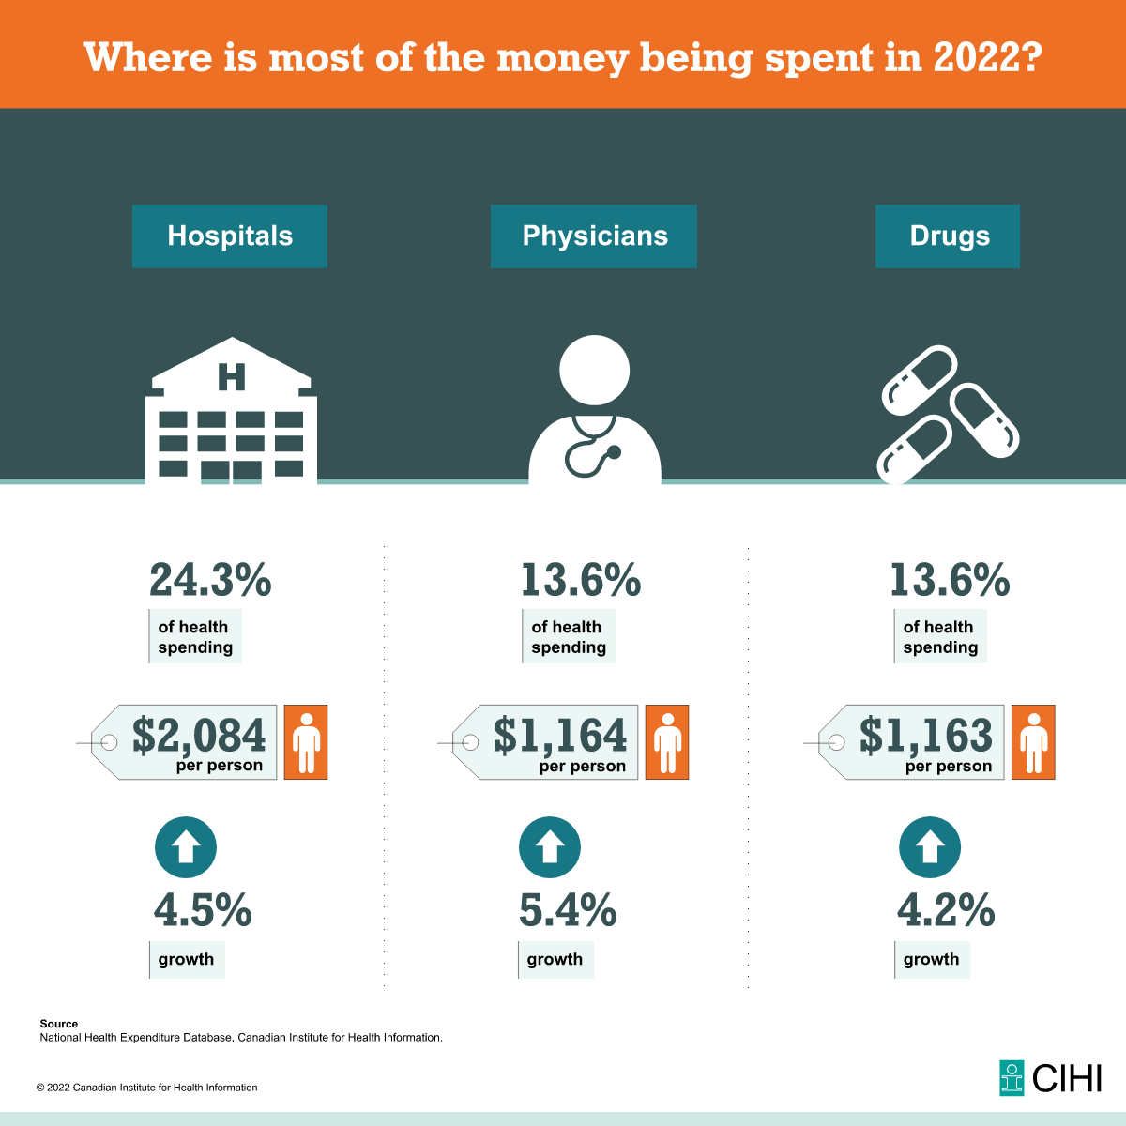
CIHI, Where is the $300 Billion being spent, 2022

Slide 39
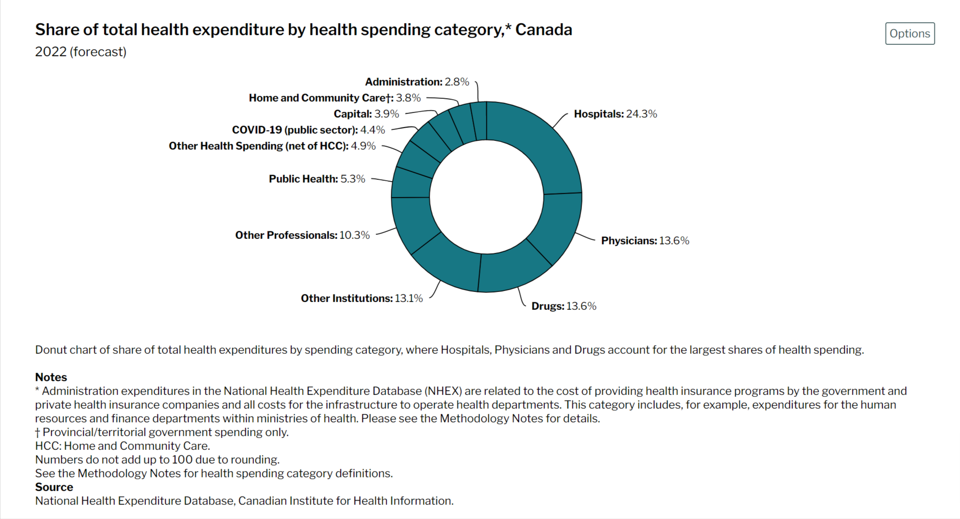
Canada, CDN Healthcare spending by category, 2022

Slide 40
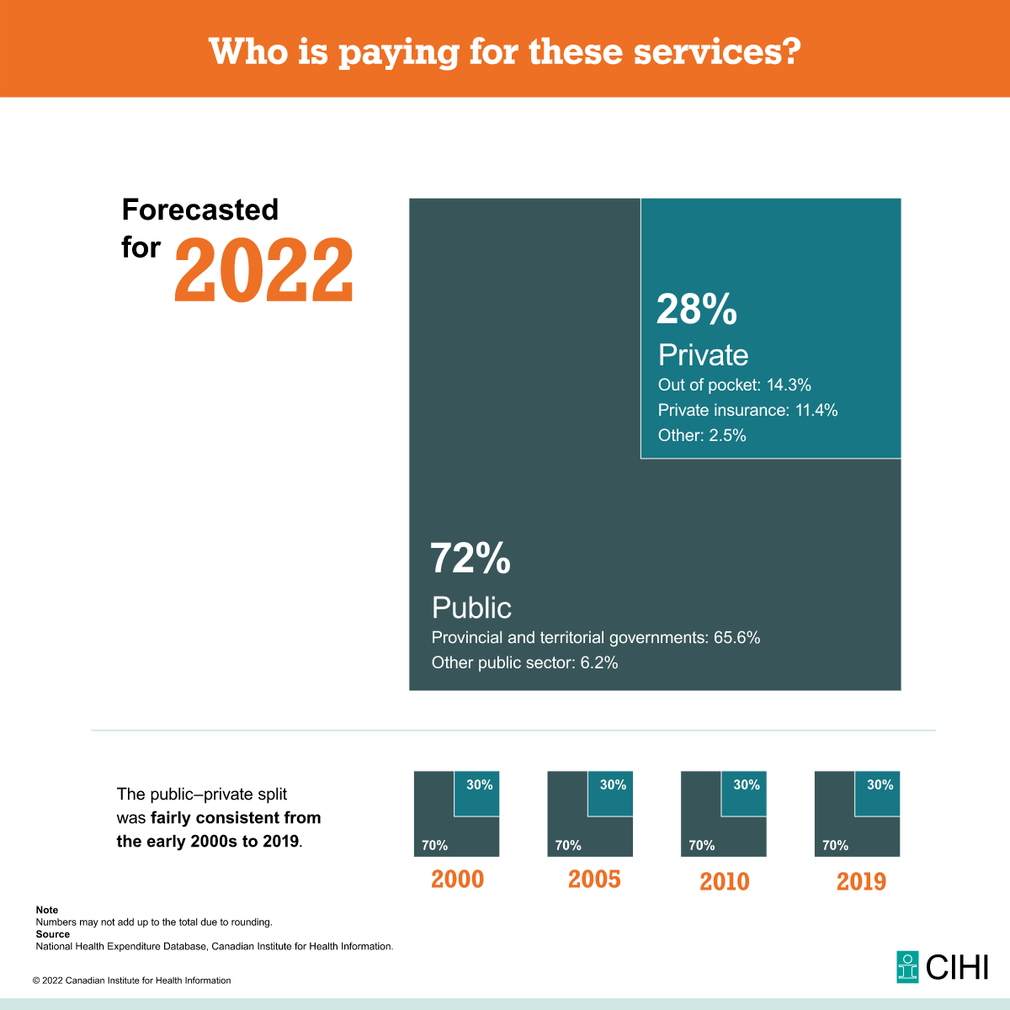
CIHI, Who is paying for healthcare, 2022
In 1967, GoC did NOT nationalize all health care NOR delivery of health care
It created SINGLE PAYER MODEL for doctors, drugs & hospitals

Slide 41
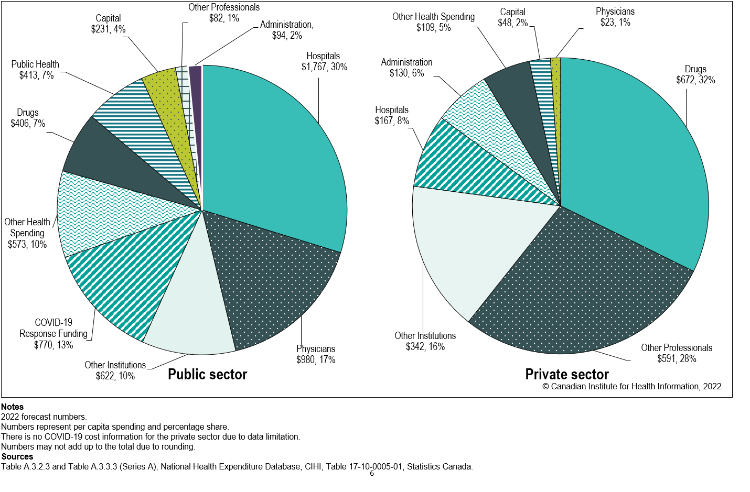
CIHI, Highest spending categories in private sector are drugs & professional

Slide 42
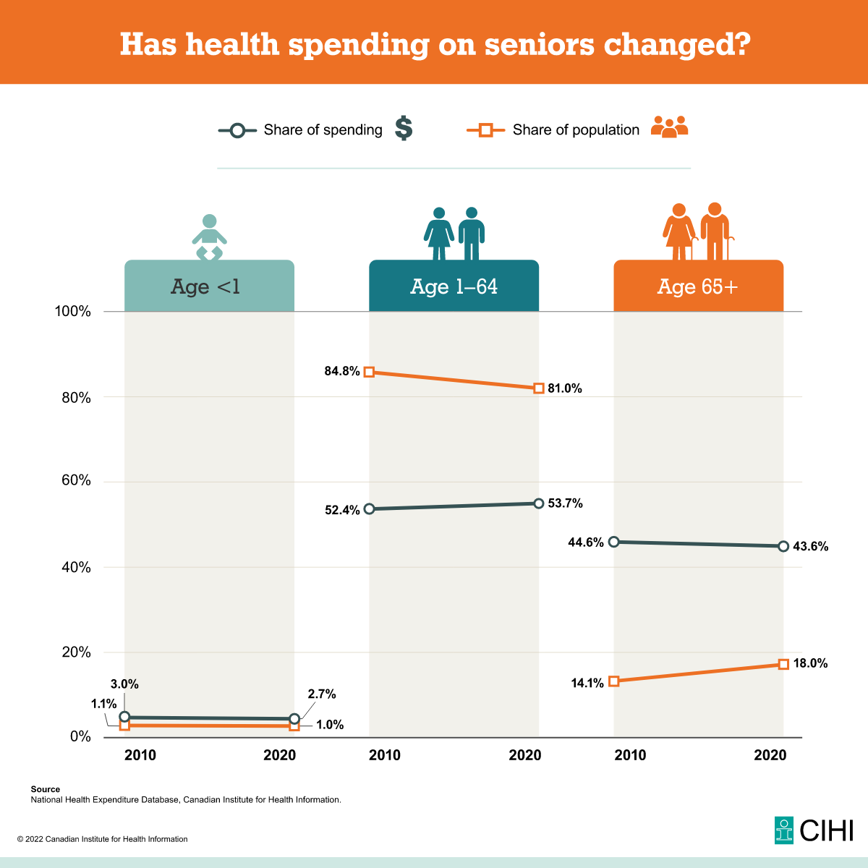
CIHI, Health spending on seniors, 2022
1/5 persons accounts for ½ spending

Slide 43
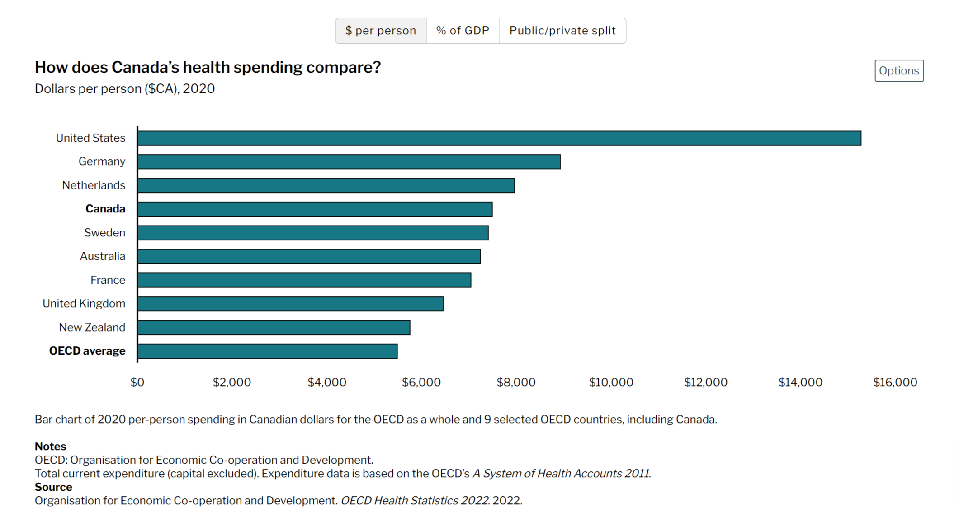
Canada, Healthcare spending by country, 2020

Slide 44
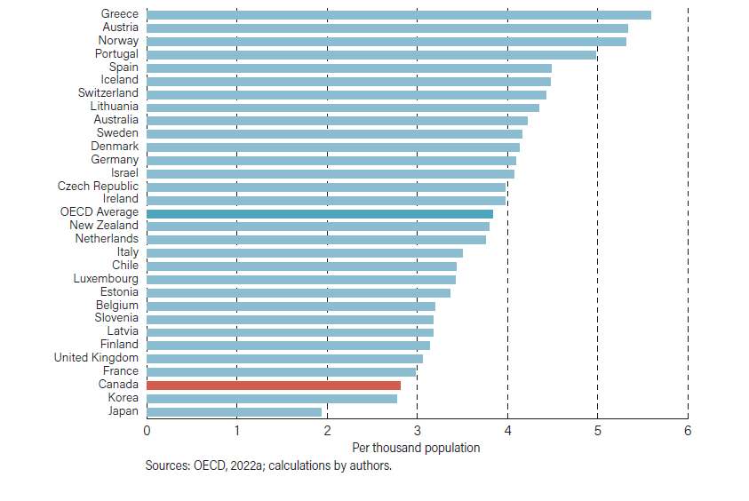
OECD, Comparative Physicians per 1000 population, 2020

Slide 45
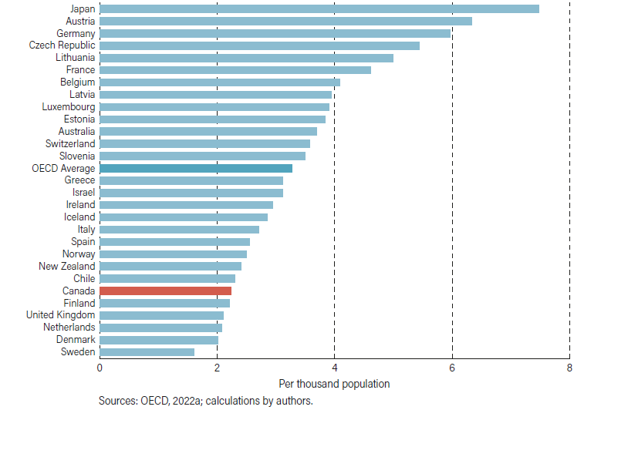
OECD, Comparative hospital beds (ex mental health), per 1000 pop, 2020

Slide 46
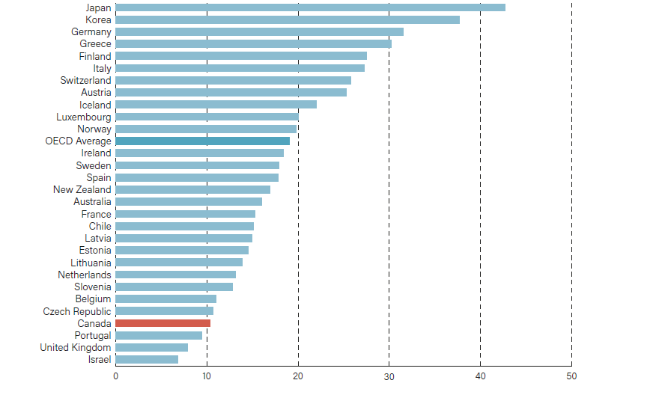
OECD, Comparative MRI Scanners per million pop, 2020

Slide 47
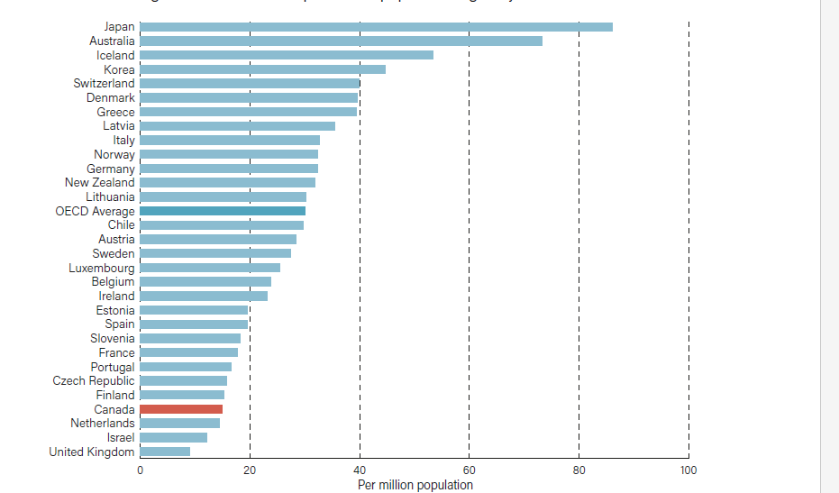
OECD, Comparative CT Scanners per million pop, 2020

Slide 48
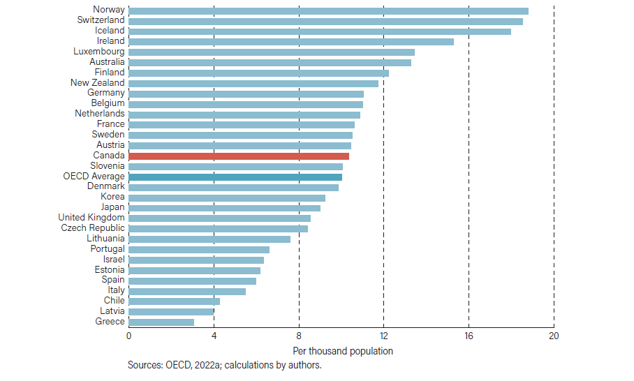
OECD, Comparative Nurses per 1000 population, 2020

Slide 49
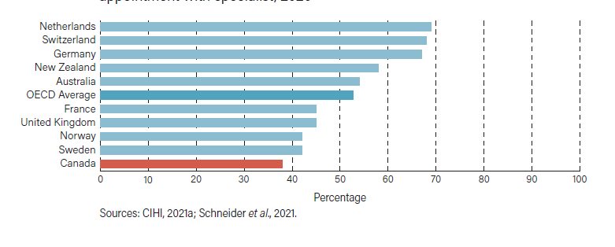
CIHI, Comparative % of patients who waited less than 4 weeks for specialist, 2020

Slide 50
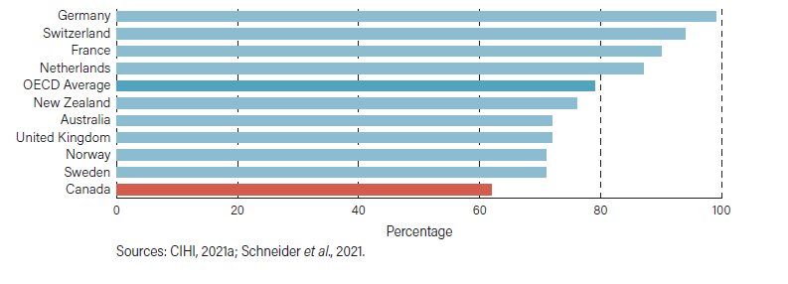
CIHI, Comparative % of patients who waited less than 4 months for elective surgery, 2020

Slide 51
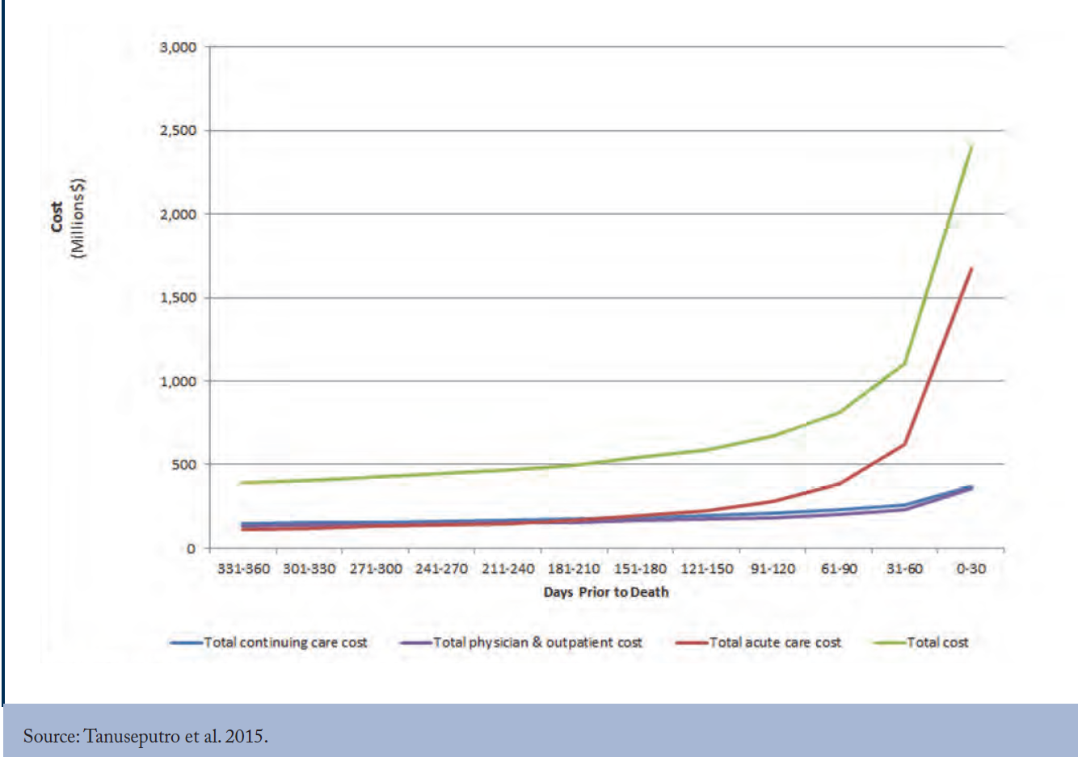
CD Howe, Ontarian health care costs in final year of life

Slide 52
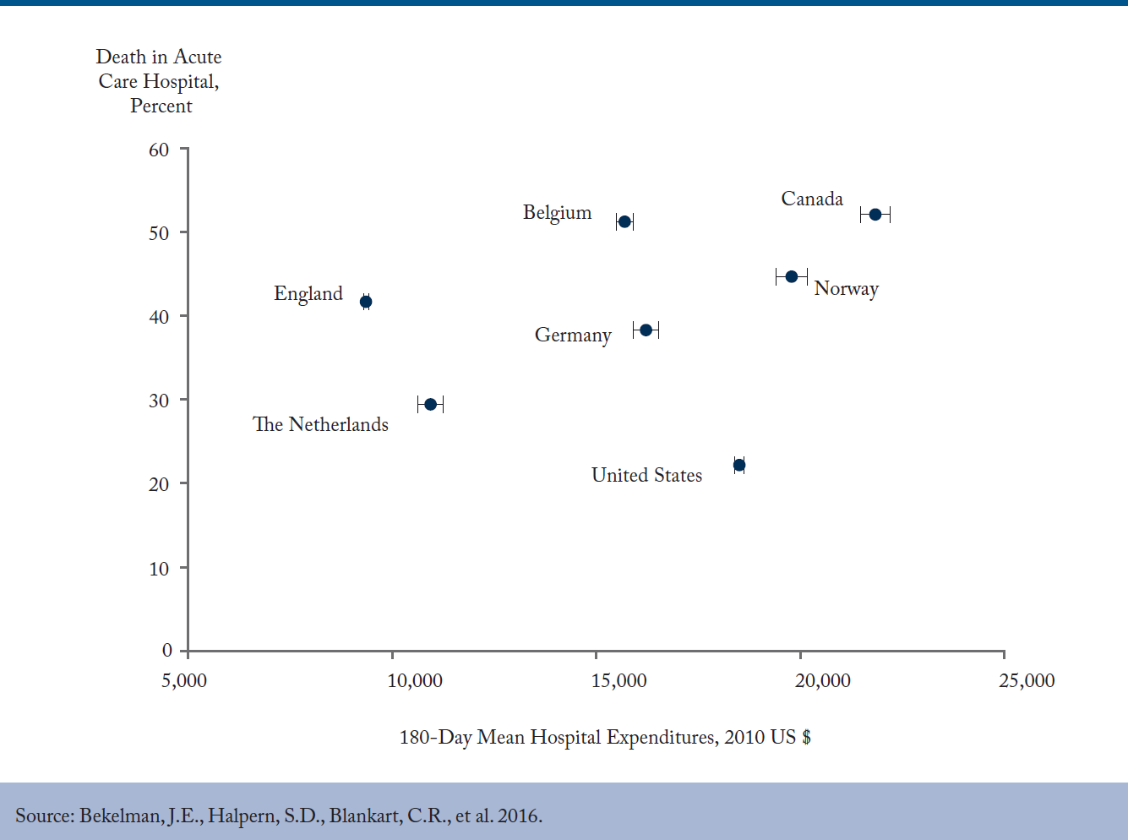
CD Howe, Comparative hospital deaths vs costs in final 180 days

Slide 53
Canada – we have a problem
It is no longer 1972 or 1992

Slide 54
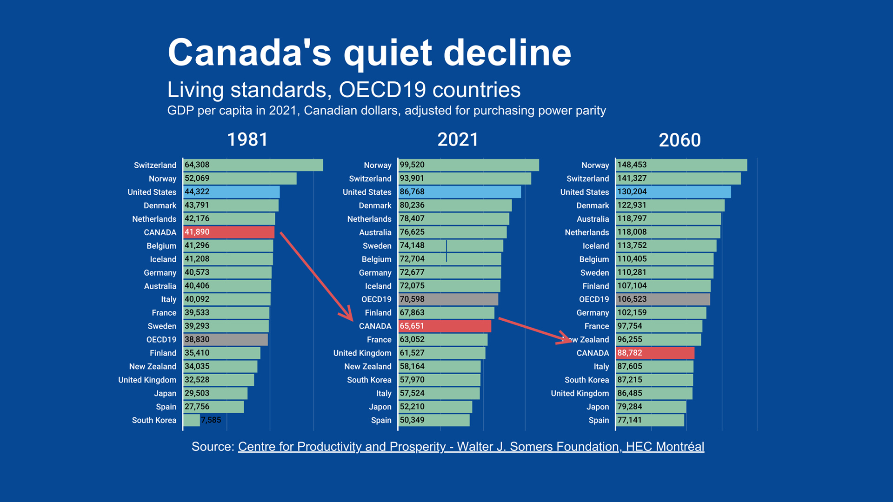
Canada’s Productivity decline, 1981-2021-2060

Slide 55
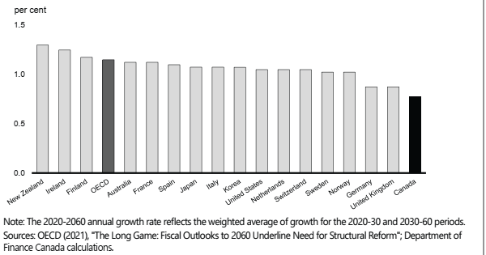
OECD Countries, Potential annual GDP per capita, 2020-2060
OECD forecasts Canada will be dead last over next 40 years

Slide 56
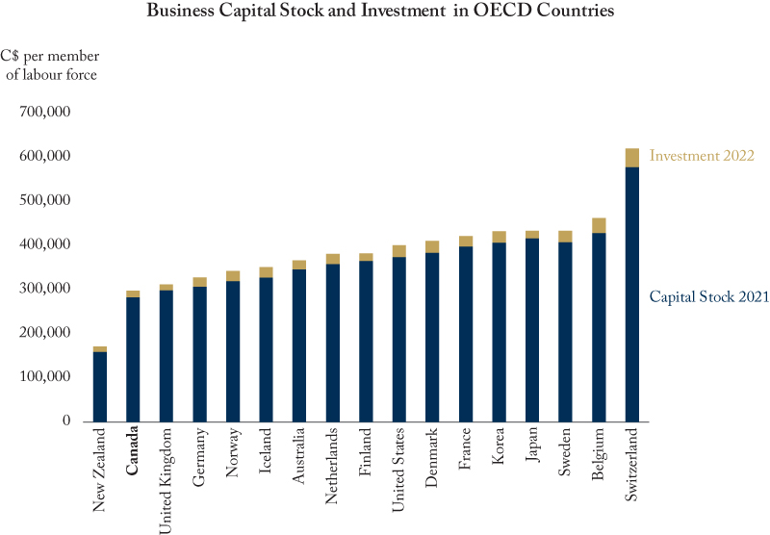
CD Howe, Biz Capital Stock & investment, 2021-22
Source: https://www.cdhowe.org/graphic-intelligence/weak-capital-investment-canada-hurts-canadian-workers

Slide 57
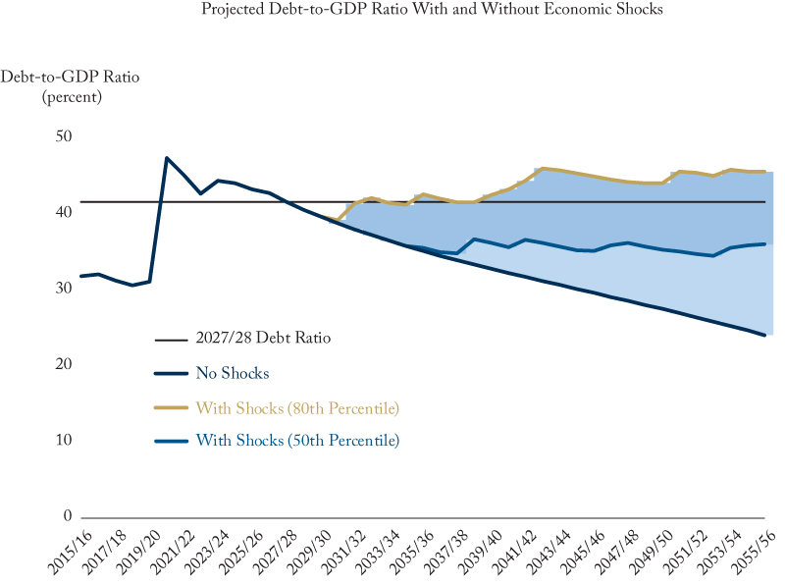
CD Howe, Projected Cdn debt to GDP ratio, 2015-2055
Source: https://www.cdhowe.org/graphic-intelligence/more-realistic-outlook-ottawa-odds-rising-debt-ratio

Slide 58
My FINA Appearance
issue of unemployment of last 50 years
From 1972-2022 now ending
see Goodhart, Great Demographic Reversal
See Ibitson & Bricker, Empty Planet
massive labour shortages foreseeable future

Slide 59
Summary
MPs still think it is 1972 or 1992
Spending massively on income support
But world has turned upside down
NOW - we desperately need workers
Must eliminate incentives to stay home

Slide 60
Why are we 2nd in spending & at bottom in delivery
In 1965 Tommy Douglas & Lester Pearson
Stated clearly: we creating single payer
Douglas stated, we NOT nationalizing health care delivery
Canada Health Act effectively did in 1984

Slide 61
Canada’s tragic health care error
Cdns slowly assumed public health care
= public delivery
ONLY country in OECD to mandate this
Yet hospitals today cost +$5 BILLION

Slide 62
Centralized hospitals vs decentralized clinics
Today hospitals very specialized, high tech
Most treatment does NOT require hospital
Hips, knees, cataracts, are done in clinics
In most countries
Do not need $2 M Ferrari to buy groceries

Slide 63
Role of Hospitals
Very serious, major health care
Heart, stroke, cancer, emergency, trauma
cannot afford to build many +$5 B hospitals
Top down vs bottom up
Centralized vs decentralized

Slide 64
NOT privatization
Private delivery funded by OHIP
Same single payer model
Just like family doctors’ practices
Cda never nationalized pharma firms
Never nationalized MRI/CT Mfg

Slide 65
Possible Solutions
Not universal pharma, dental or child care
Need decentralized health care
Clinic centric – not hospital centric
Complete digitization of health records
Rapid natl credentialization of MDs, nurses

