Slide 1

Can Lanark County Pull its Weight?
A Pathway to Addressing the Climate Crisis in Lanark County

Slide 2
Susan Brandum
Co-Founder with Gord Harrison and Director of Climate Network Lanark
20 years Manager, Rideau Environmental Action League
Helped develope national EnerGuide for Houses, award for Well Aware, developed REAL Deal Reuse Store
Former reporter, specialist energy writer, corporate and government
Climate Network Lanark
Formed 2019. Non-profit formed 2023.
1000 Supporters, 50 core volunteers

Slide 3
Why Form Climate Network Lanark?
The climate crisis is “the biggest threat to security that modern humans have ever faced.” David Attenborough
“If we continue on our current path, we will face the collapse of everything that gives us our security”: food production, access to fresh water, habitable ambient temperature and ocean food chains. Secretary-General António Guterres.
Climate change is a “crisis multiplier.”
Action/Inaction at the International, National, Provincial levels
No one level of government or business or civil society is going to solve it

Slide 4
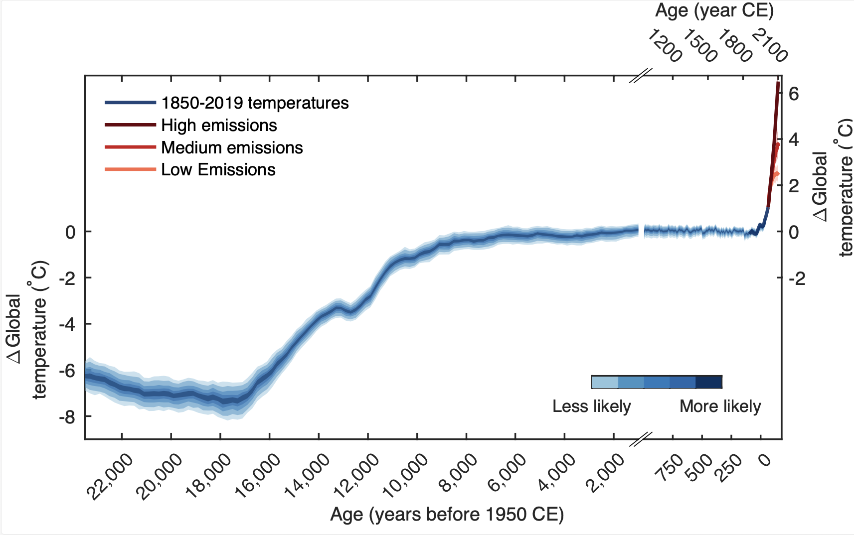
Revised ‘Hockey Stick’ 2021

Slide 5
IT TAKES ALL OF US
IPCC targets
Now 1.1 C above pre-industrial levels
Target 1.5 C
Cut emissions in half by 2030
Conserve 30-50% of the Earth’s land and waters
Canadian national target 40-45% GHG emissions cut by 2030
Take a minute to imagine what cutting your emissions in half by 2030 means – cutting your use of gasoline, of natural gas, of electricity produced with natural gas, of food fertilized with fossil fuels, of plastics made from fossil fuels
Not easy, but doable – why there is such a focus on cutting methane/natural gas, 80 x worse global heating than CO2
But only doable if we ALL are engaged in the project
CNL formed to focus on our LOCAL governments and actions

Slide 6
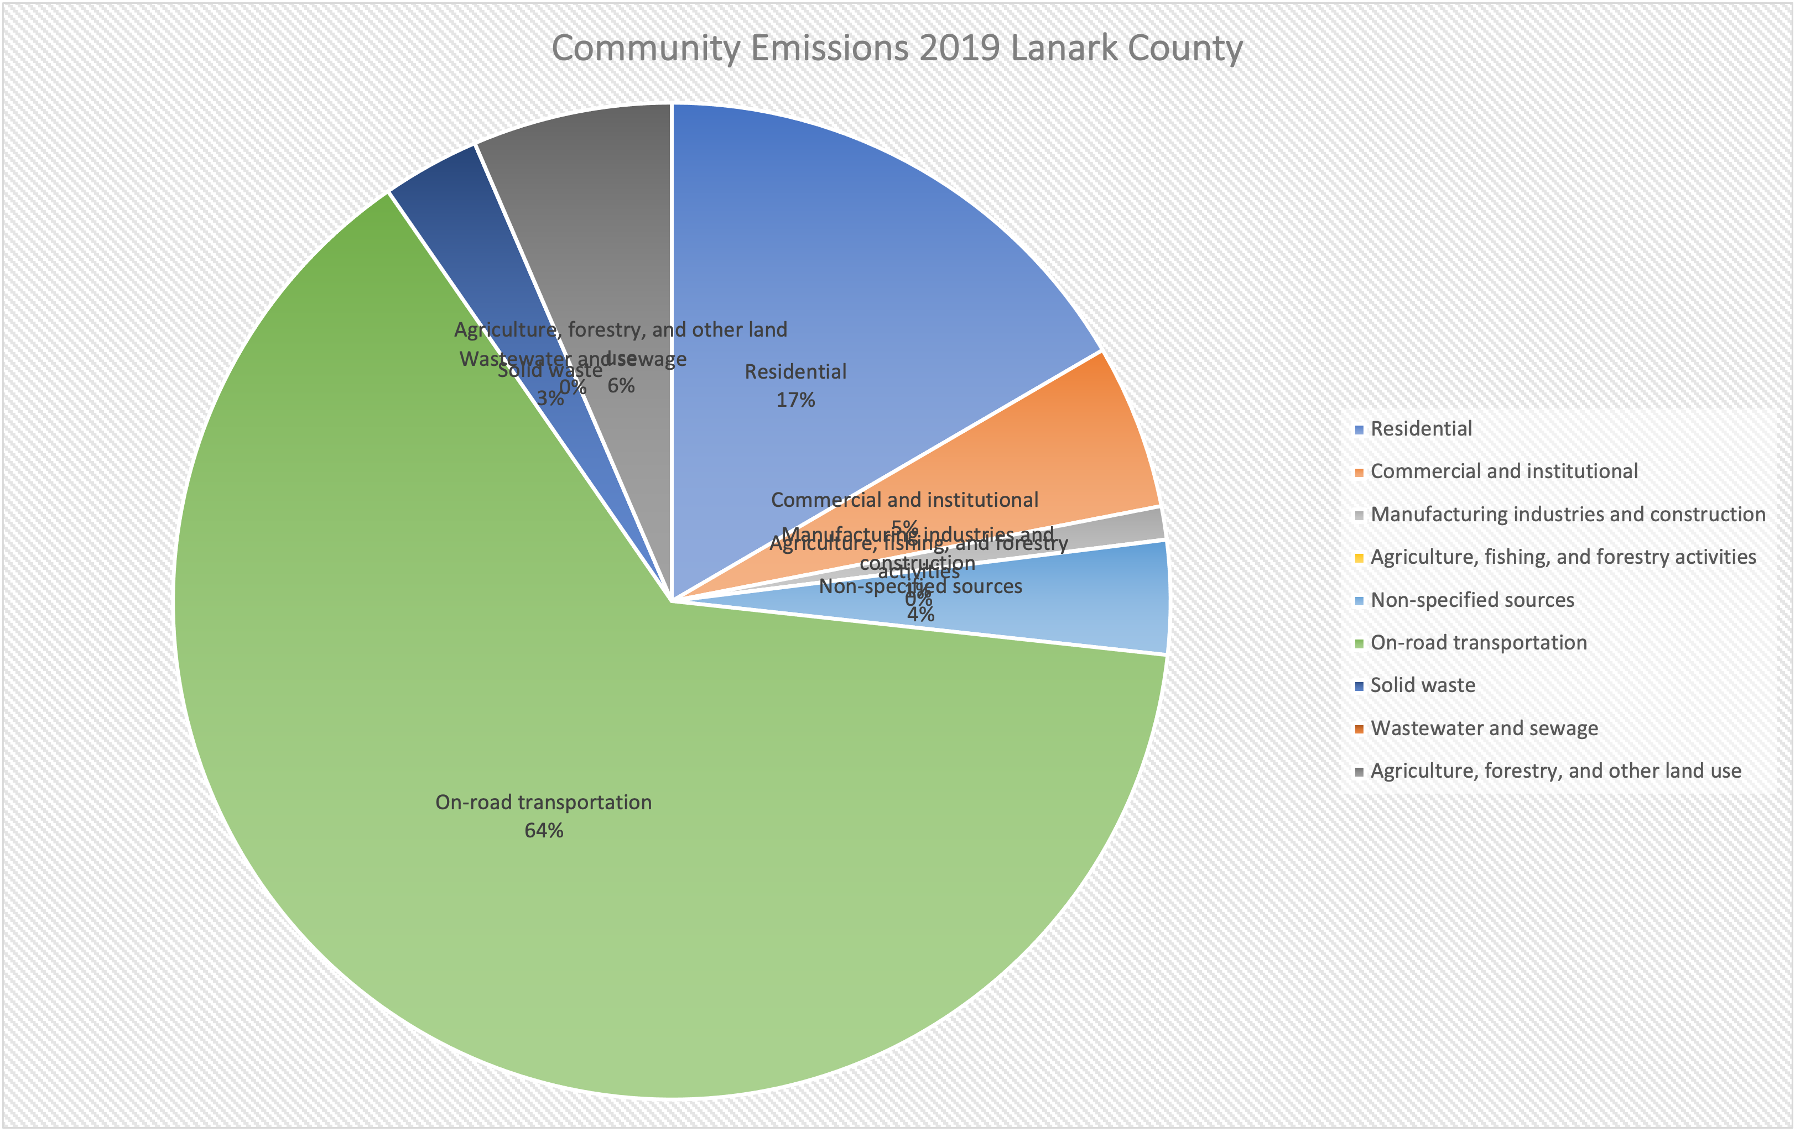
Community Emissions Lanark County 2019

Slide 7
What has CNL done to date?
Pushed Lanark County to agree to develop a Climate Action Plan 2019. Unanimous vote. All 8 of lower-tier municipalities including Perth, Tay Valley Township, Lanark Highlands, Drummond North Elmsley, Carleton Place, Mississippi Mills (Almonte), Beckwith and Montague. Smiths Falls supporting.
Brought ALUS to Lanark County (more later)
Conducted a County wide survey of practices and attitudes about climate action here (more later)
Designed and sat on the first year of the County’s Climate Action Committee.
Submitted about 3/4 of the ideas in the County’s Climate Action Tables (Tables lists)

Slide 8
What has CNL done to date?
Brought ALUS to Lanark County
Alternative Land Use Services
ALUS helps farmers and ranchers build nature-based solutions on their land.
Community developed, farmer delivered, science based.
Managed by RVCA, partnership includes MVC and County
2022 first year in operation – created 3 wetlands projects
https://alus.ca/alus_community/alus-lanark/

Slide 9
What has CNL done to date?
Conducted a County wide survey of practices and attitudes about climate action. 900 people completed the survey. Plan to run it again, fall 2023
Average household size is 2 people (this is consistent with Stats Canada findings for this region, but is meaningful when discussing household size and energy use.)
53% were over 65, 35% were 41-65, 11% were 19-40, and 1% were under 18.
55% of our respondents were either retired or not working, though the survey was conducted during the Covid pandemic. Even so, 31% said they worked remotely, either full or part-time.
61% said they did not belong to or support any local or other environmental organization.
Still, 87% of all respondents said they were extremely or very concerned about climate change and 94% said climate change is already affecting Eastern Ontario.
96% said it is very or somewhat important that local municipal governments and Lanark County reduce their own GHG emissions and 95% said it is very or somewhat important that those same local governments help residents and businesses reduce GHGs.

Slide 10
What has CNL done to date?
Survey Results con’t
86% said their own households should do more to reduce GHG emissions.
About 31% had a pick-up truck. About 15% had either a hybrid electric vehicle or a full electric vehicle and 30% said they planned to buy an EV in the next 10 years.
91% owned their own dwelling which means there is huge opportunity for GHG savings, especially since about 60% of those dwellings are more than 30 years old.
Among all the respondents, only 8, or less than 1%, had solar PV, again pointing to huge potential.
As well, only 8% use an electric heat pump, while about 70% use some form of fossil fuels, again pointing to an enormous opportunity for GHG reduction.
Just about 75% compost kitchen scraps. A variety of reasons were given by the ¼ who don’t compost and 43% had not understood that organic materials going into landfill generated methane, a Greenhouse Gas that is 80 times more destructive than carbon dioxide.
About 10% of respondents use a burn barrel.
Just about half of respondents reported that they had beef in only one meal a week.
Close to half said they planned to create pollinator gardens, the single most favoured gardening improvement.

Slide 11
What has CNL done to date?
Designed and sat on the County’s Climate Action Committee through 2021-22. Purposefully ensured there was citizen representation on the committee
Drawing on about 50 core volunteers engaged in CNL’s Working Groups on Buildings and Energy, Transportation, Farms and Food, Waste and Composting, CNL submitted about 3/4 of the ideas in the County’s Climate Action Tables.

Slide 12
Lanark County Tables of Climate Action
Important to note that Climate Network Lanark perceives these Tables, which form the basis of the County’s Climate Action Plan, as OUR plan, as the plan for the whole of the County, not just the County government, to implement.
That said, there are two sets of Tables, one for the Corporation of the County, regarding their Corporate assets, the other for the Community.
In developing the Tables, Council adopted 6 guiding principles:
Create a climate conscious culture and community
Eliminate fossil fuels
Maximize energy efficiencies and increase renewable energy generation
Reduce waste
Increase funding, accessibility and education
Sequester carbon and protect natural resources

Slide 13
Climate Lens
Council also voted last year to apply the Climate Lens in all their decisions.
Climate Lens – developed by local expert Bob Argue – ecoPerth
Tool to evaluate the Greenhouse Gases emitted by a particular decision against its cost-effectiveness.
Very valuable tool
In use by Perth and Tay Valley Township

Slide 14
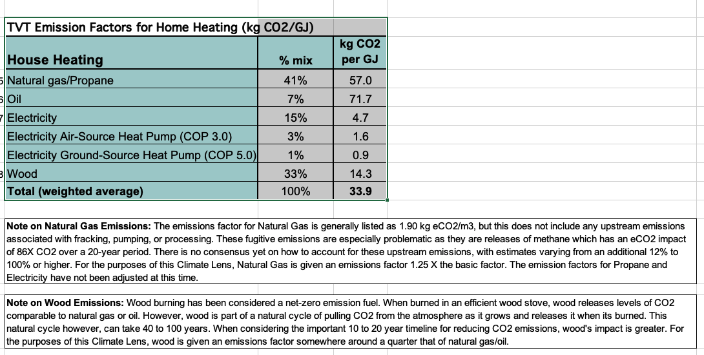
Climate Lens

Slide 15
Lanark County CORPORATE Climate Actions Table Highlights
Use the Climate Lens
Internal staff education
Building and water efficiency actions
Upgrade to electric vehicles
Install solar systems on municipal buildings where possible
All new hand power tool purchases to be electric
Plan for the rebuild of all County buildings to be net zero – Lanark Lodge?

Slide 16
Eg. - Social Housing Retrofits
Recent story – Retrofits of 3 social housing complexes.
Did not use Climate Lens
Did not follow policy of eliminating fossil fuels
Never formally evaluated hat pumps, nonetheless electric air source mini-split heat pumps with electric baseboard back up
Caused commotion
All old and new Councillors now aware of County commitments to climate action
Additional motion to have staff bring forward information on terms for a contract to investigate alternative heating options for other housing units from the housing consultants.

Slide 17
Lanark County COMMUNITY Climate Actions Table
Stress COMMUNITY
For us, and every business, organization and individual in the community
This is what we are to do.
Therefore, we need involvement, engagement
More than 40 listed actions.
https://www.lanarkcounty.ca/en/environmental-initiatives/resources/Community-Climate-Action-Table-Final.2.pdf

Slide 18
Lanark County COMMUNITY Climate Actions Table Highlights
Education, websites, information sessions, etc. for public, trades, others
Increase public EV chargers
Electrify Lanark Transportation fleet
Investigate and plan to adopt innovative public transit systems
Policy changes to create 15-minute communities
Incentivize building efficiency through numerous programs
Escalate composting of organic waste – single easiest and cheapest thing you can do for the climate – and reduction of food waste
Supports for farmers, ALUS
Strengthen support for Natural Heritage Systems – Nature Based Climate Solutions – specifically wetlands

Slide 19
Some County and Municipal Climate Actions Underway
County’s climate actions
1 million tree program
Solar PV on social housing
EVs for lower tier munis
Plastic bag voluntary ban
Lower-tier Climate Action Committees
Tay Valley Township
Perth (1 year)
Smiths Falls

Slide 20
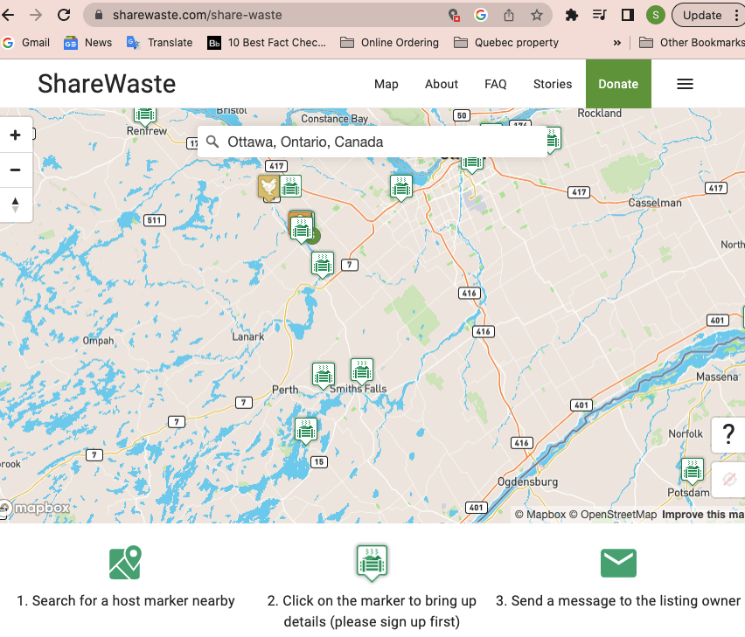
Some CNL Actions Underway - Developing and promoting various composting programs – fungal dominant, Mississippi Mills Just Good Compost, ShareWaste

Slide 21
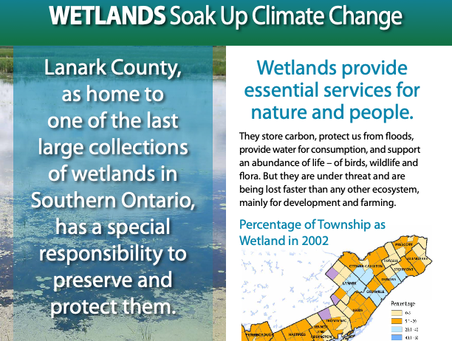
Some CNL Actions Underway – Wetlands project
Leading Action in Lanark County to develop new policies on wetlands and their protection by local municipalities.

Slide 22
Some CNL Actions Underway – Climate Concierge Project
Pilot test
Community Clusters in Almonte, Carleton Place, Lanark Village, Perth and Smiths Falls
One business cluster
Share information on how to best cut GHGs in the home and small business building
Access to programs, financing
Access to trades
Knowledge about suppliers, how things work etc.
Sign up

Slide 23
Lanark County targets
Corporate – 20%
Community – not set yet
FCM says 45% by 2030

Slide 24
Can Lanark County Pull its Weight?
Further ahead than most municipalities in Eastern Ontario, from Peterborough East to the Quebec border.
Most of the way to having a Climate Action Plan for Mitigation. Plan should be done this year.
Having a Climate Action Plan opens the door to accessing large funds for climate actions through the Federation of Canadian Municipalities.
Have to do an Adaptation Plan
Lanark County has Climate Network Lanark. Not aware of any such large civilian climate organization elsewhere in Eastern Ontario. Seen as a model by others in the region.
Have huge public support, 1000 supporters of CNL, 1300 signed the petition on the social housing retrofits as examples.
Achieved an enormous amount in past 3 years, now have to implement!

Slide 25
What does a 45% cut by 2030 mean?
Gotta get on with it
Need everyone involved
Every local level of government has to have a plan, every business has to have a plan, every organization has to have a plan, every household a plan.
Challenge to you. What is Probus doing? Where do you generate most of your GHGs? How are you cutting your GHGs resulting from these meetings? Do you have an active car pooling program for eg?
How do we all do it?
?
How do you do it? Assuming that your emissions match those of the County – transportation highest, buildings next and organic waste in third place.
Youth say “System Change, Not Climate Change”
Guilt is generally not a good personal motivator.
Need System Changes – so burden doesn’t fall completely on the individual.
NEED LOCAL GOVERNMENTS TO UNDERSTAND THIS IS WHAT WE WANT, AND THAT WE CAN WORK WITH THEM, AND THEY WITH US, TO ACHIEVE THIS CUT.
If we don’t work together, we won’t get there.

Slide 26
Climate Legacy
Seniors acting for a sustainable planet
Based in Ottawa, National scope
What can you do with your Voice, your Time and your Money?
https://www.climatelegacy.ca/

Slide 27
Donate to CNL
I used to be embarrassed to ask for donations to the environmental groups I was in.
No more.
This truly is the future of life on this planet.
CNL uses its little money to pay for part-time staff to support our work. We have no office, little overhead.
I cannot imagine a more worthy cause than the life of this beautiful Earth and its inhabitants including us.
https://climatenetworklanark.ca/donate/
Charitable tax receipts issued by Salal Foundation which supports CNL

Slide 28
THANK YOU !

